Slide 1
Compounds

Slide 2
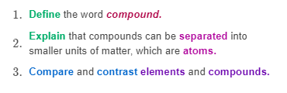
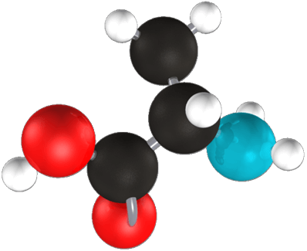

Slide 3
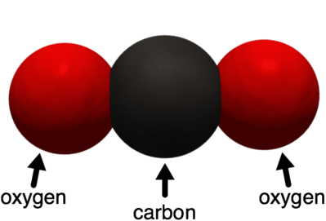
If a particle contains more than one kind of atom, we call that substance a compound.
A compound is a substance with two or more types of atoms which are chemically bonded together.

Slide 4
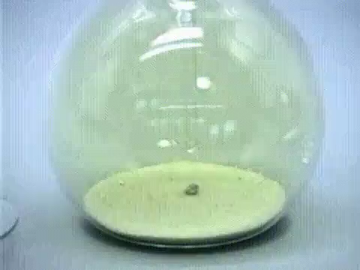
The properties of compounds are very different from the elements that they are made of.
Let's look at the compound sodium chloride. The chemical formula is NaCl.
Sodium (Na) is an incredibly reactive metal. Chlorine (Cl_{2​}) is a highly poisonous gas. When combined together, they react explosively.

Slide 5
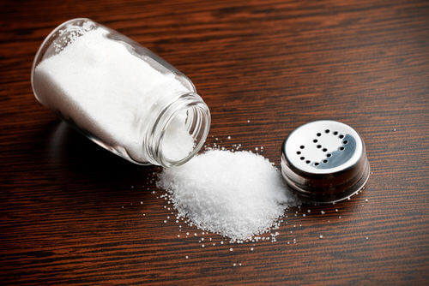
But when sodium and chlorine are bonded together, they form table salt (NaCl)!

Slide 6
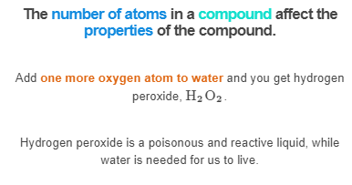

Slide 7
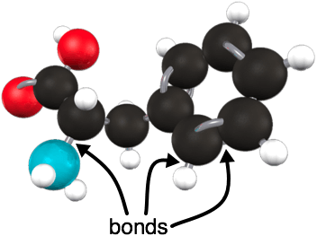
In compounds, atoms are held together with strong chemical bonds.
Compounds are therefore difficult to separate due to their chemical bonds. A chemical bond is the attraction between two atoms.

Slide 8
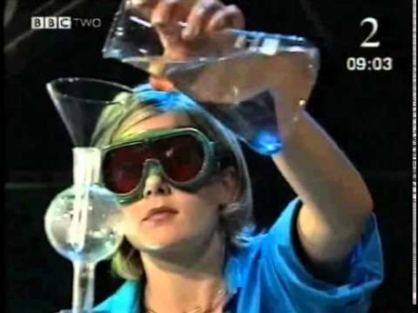
Elements can only be separated out from compounds by a chemical reaction.
Watch the video below (1:38) to see just how difficult it is to separate them.

